Slide 1

Lesson 02 Ladder Logic Simulation with OpenPLC Editor
Dr. David J. Coe
Electrical and Computer Engineering Department
University of Alabama in Huntsville
coed@uah.edu

Slide 2
Outline
Review
Simulation of Ladder Logic
Suggested Reading
Hands-On Laboratory Exercise #2

Slide 3
Review

Slide 4
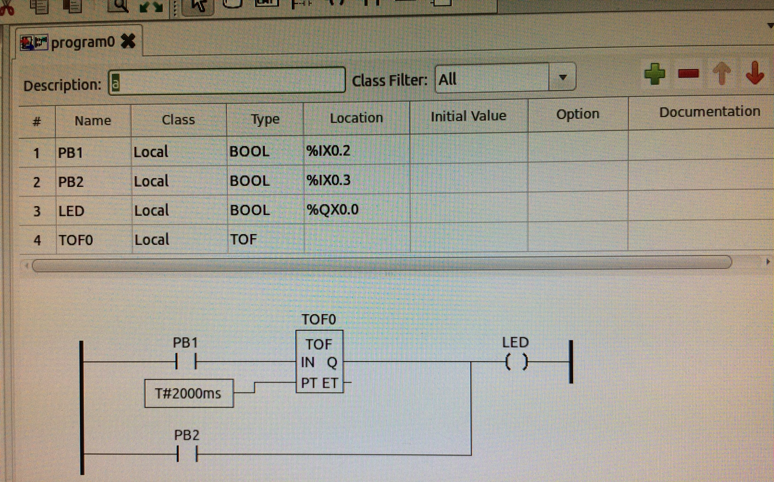
Sample Ladder Logic in OpenPLC Editor
LED lights whenever PB2 is pressed
LED lights for 2 sec after PB1 is pressed
LED is off otherwise

Slide 5
Simulation of Ladder Logic

Slide 6
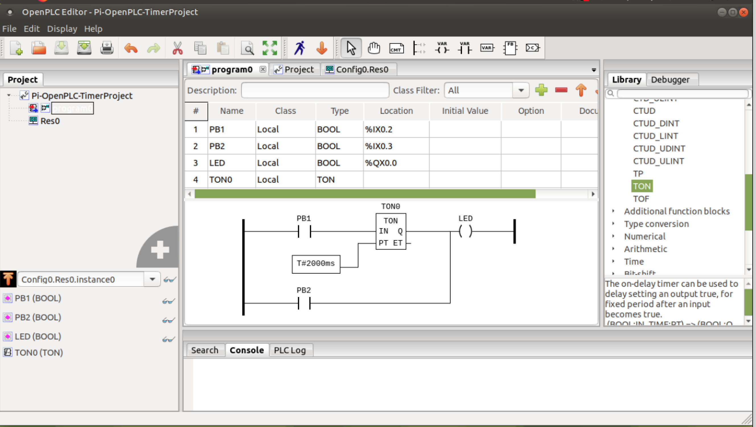
Ladder Logic Simulation - 1
Start OpenPLC Editor simulator

Slide 7
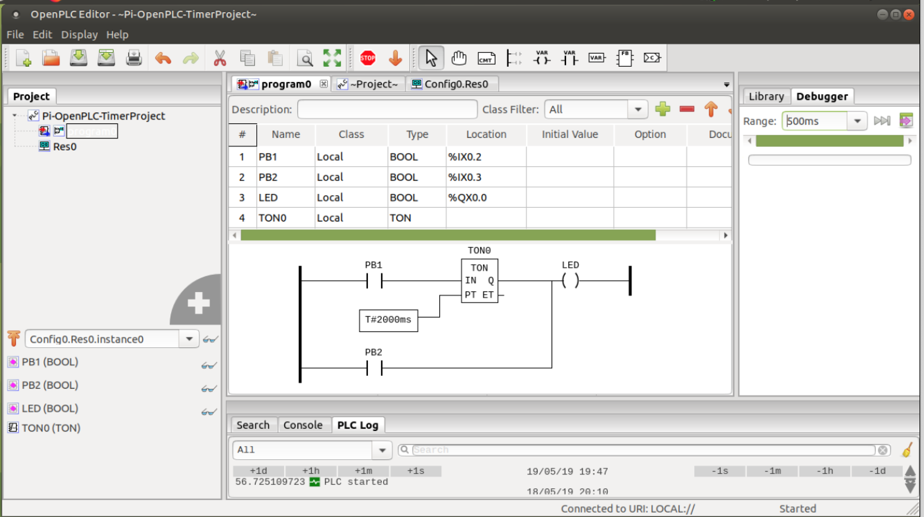
Ladder Logic Simulation - 2
Select instance to debug
(Makes energized components visible in your ladder logic)

Slide 8
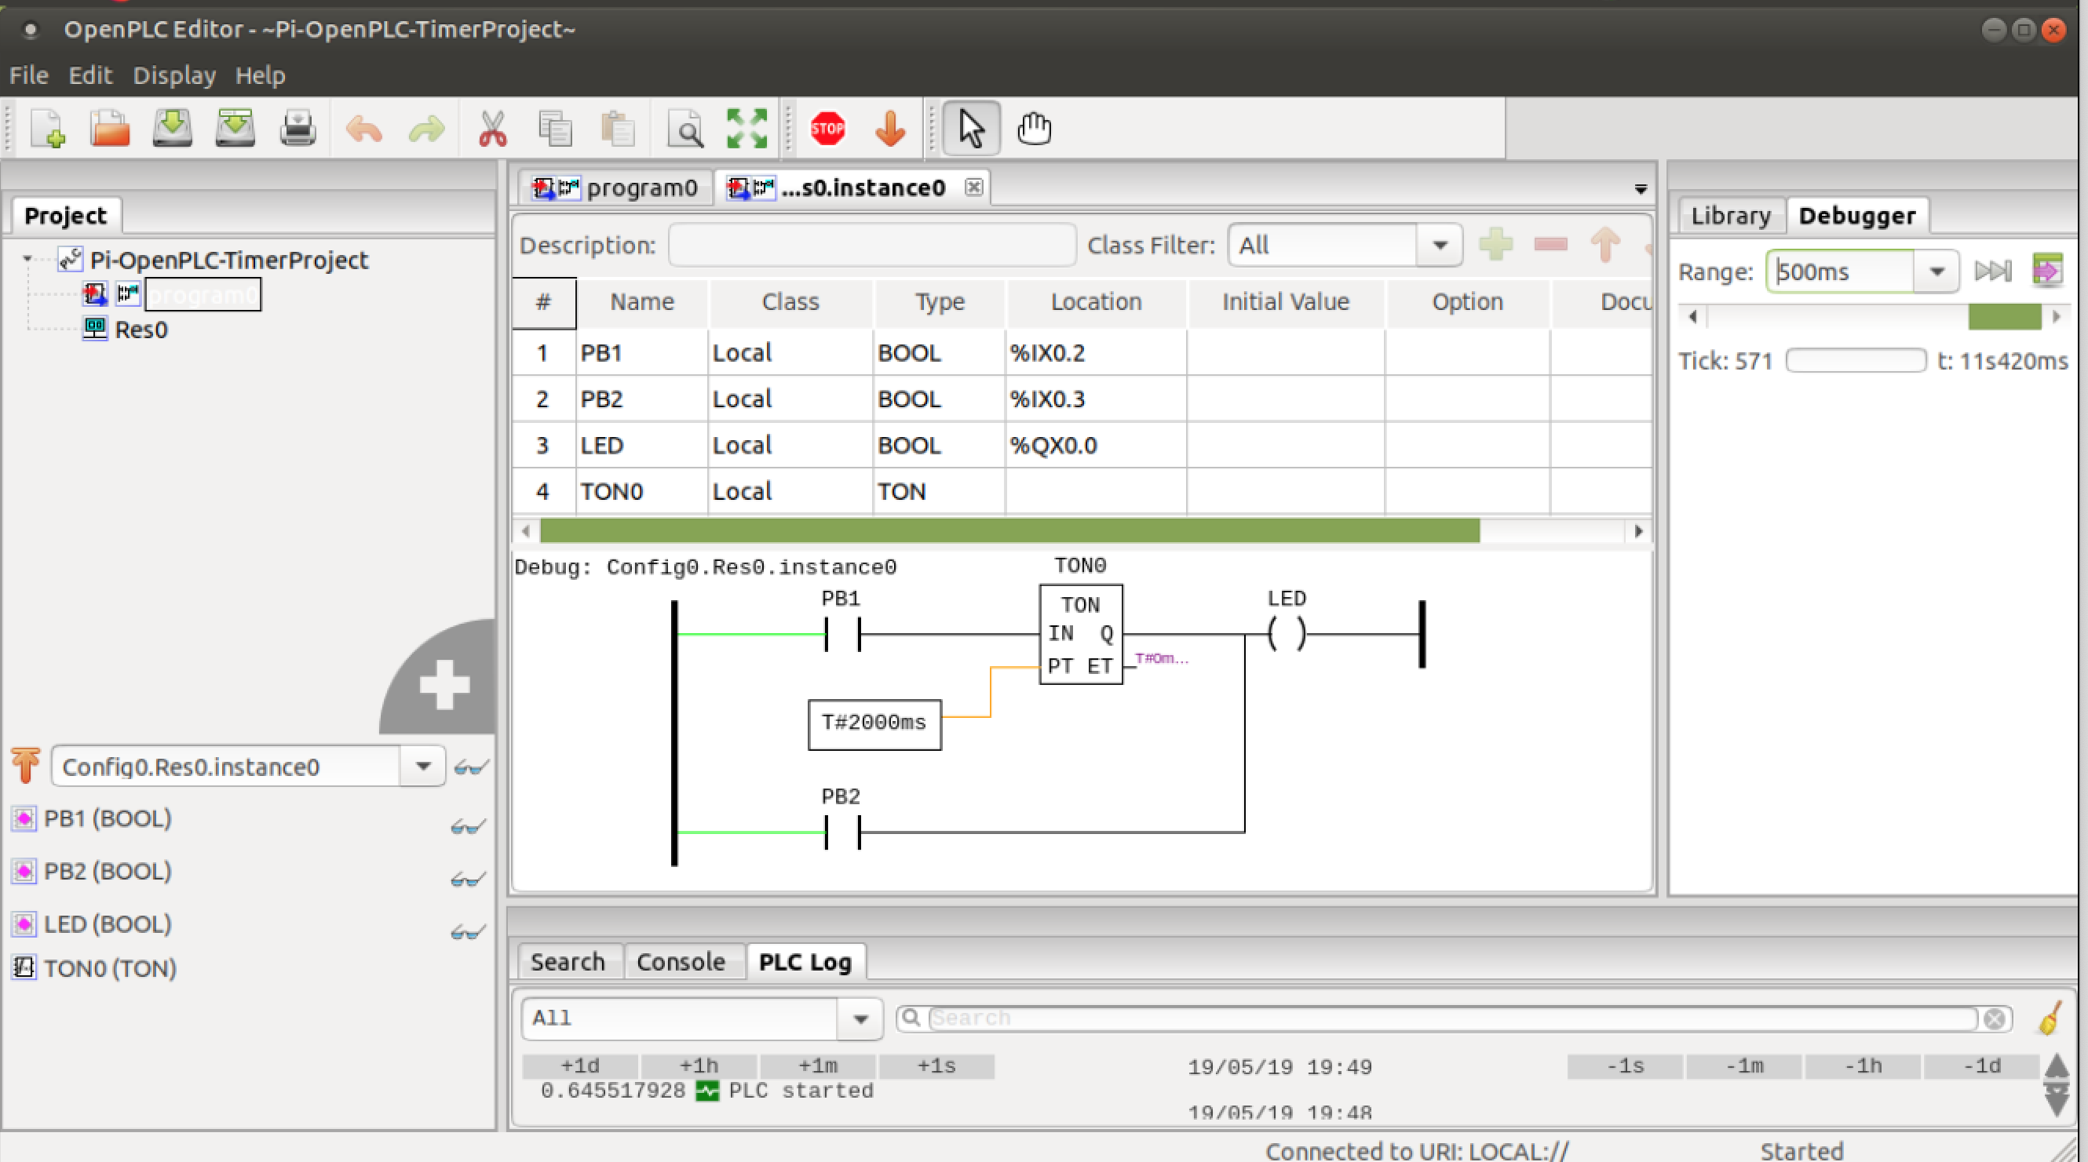
Ladder Logic Simulation - 3
Select variables to view

Slide 9
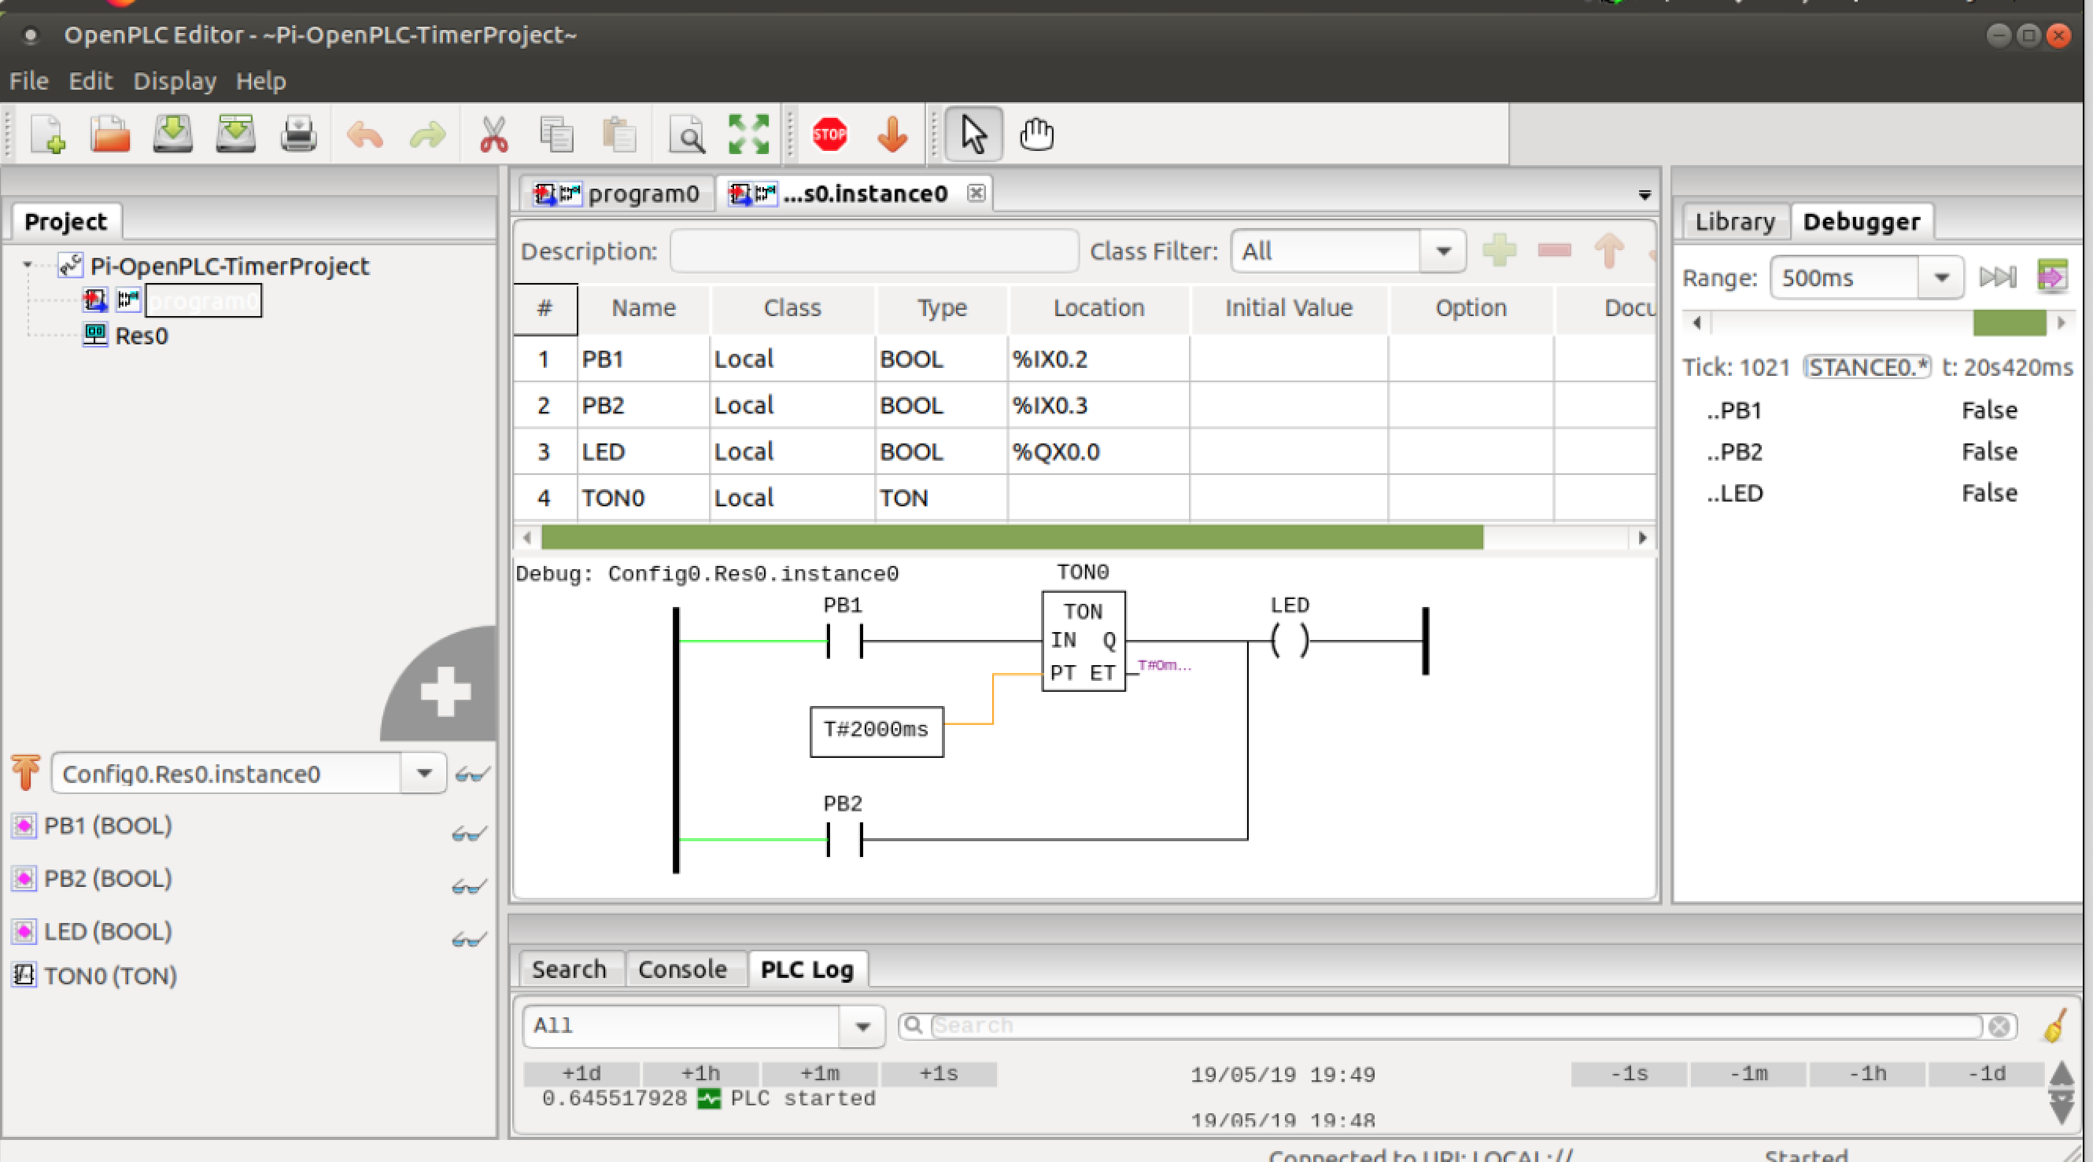
Ladder Logic Simulation - 4
Variable values appear on right
PB1 and PB2 false ➔ wires to right not energized (black)
LED false ➔ no light emitted

Slide 10
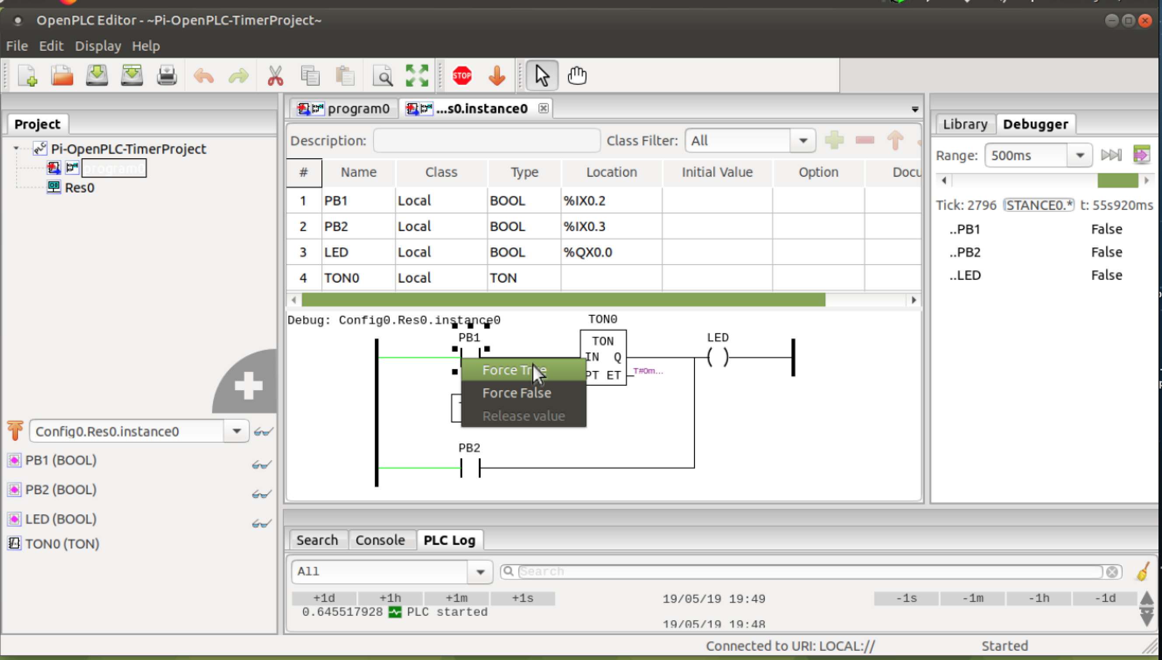
Ladder Logic Simulation - 5
Force PB1 to true to simulate button press
(right-click on PB1 to see menu)

Slide 11

Ladder Logic Simulation - 6
Green path through PB1 and LED from left rail to right rail
LED coil now energized ➔ light emitted

Slide 12
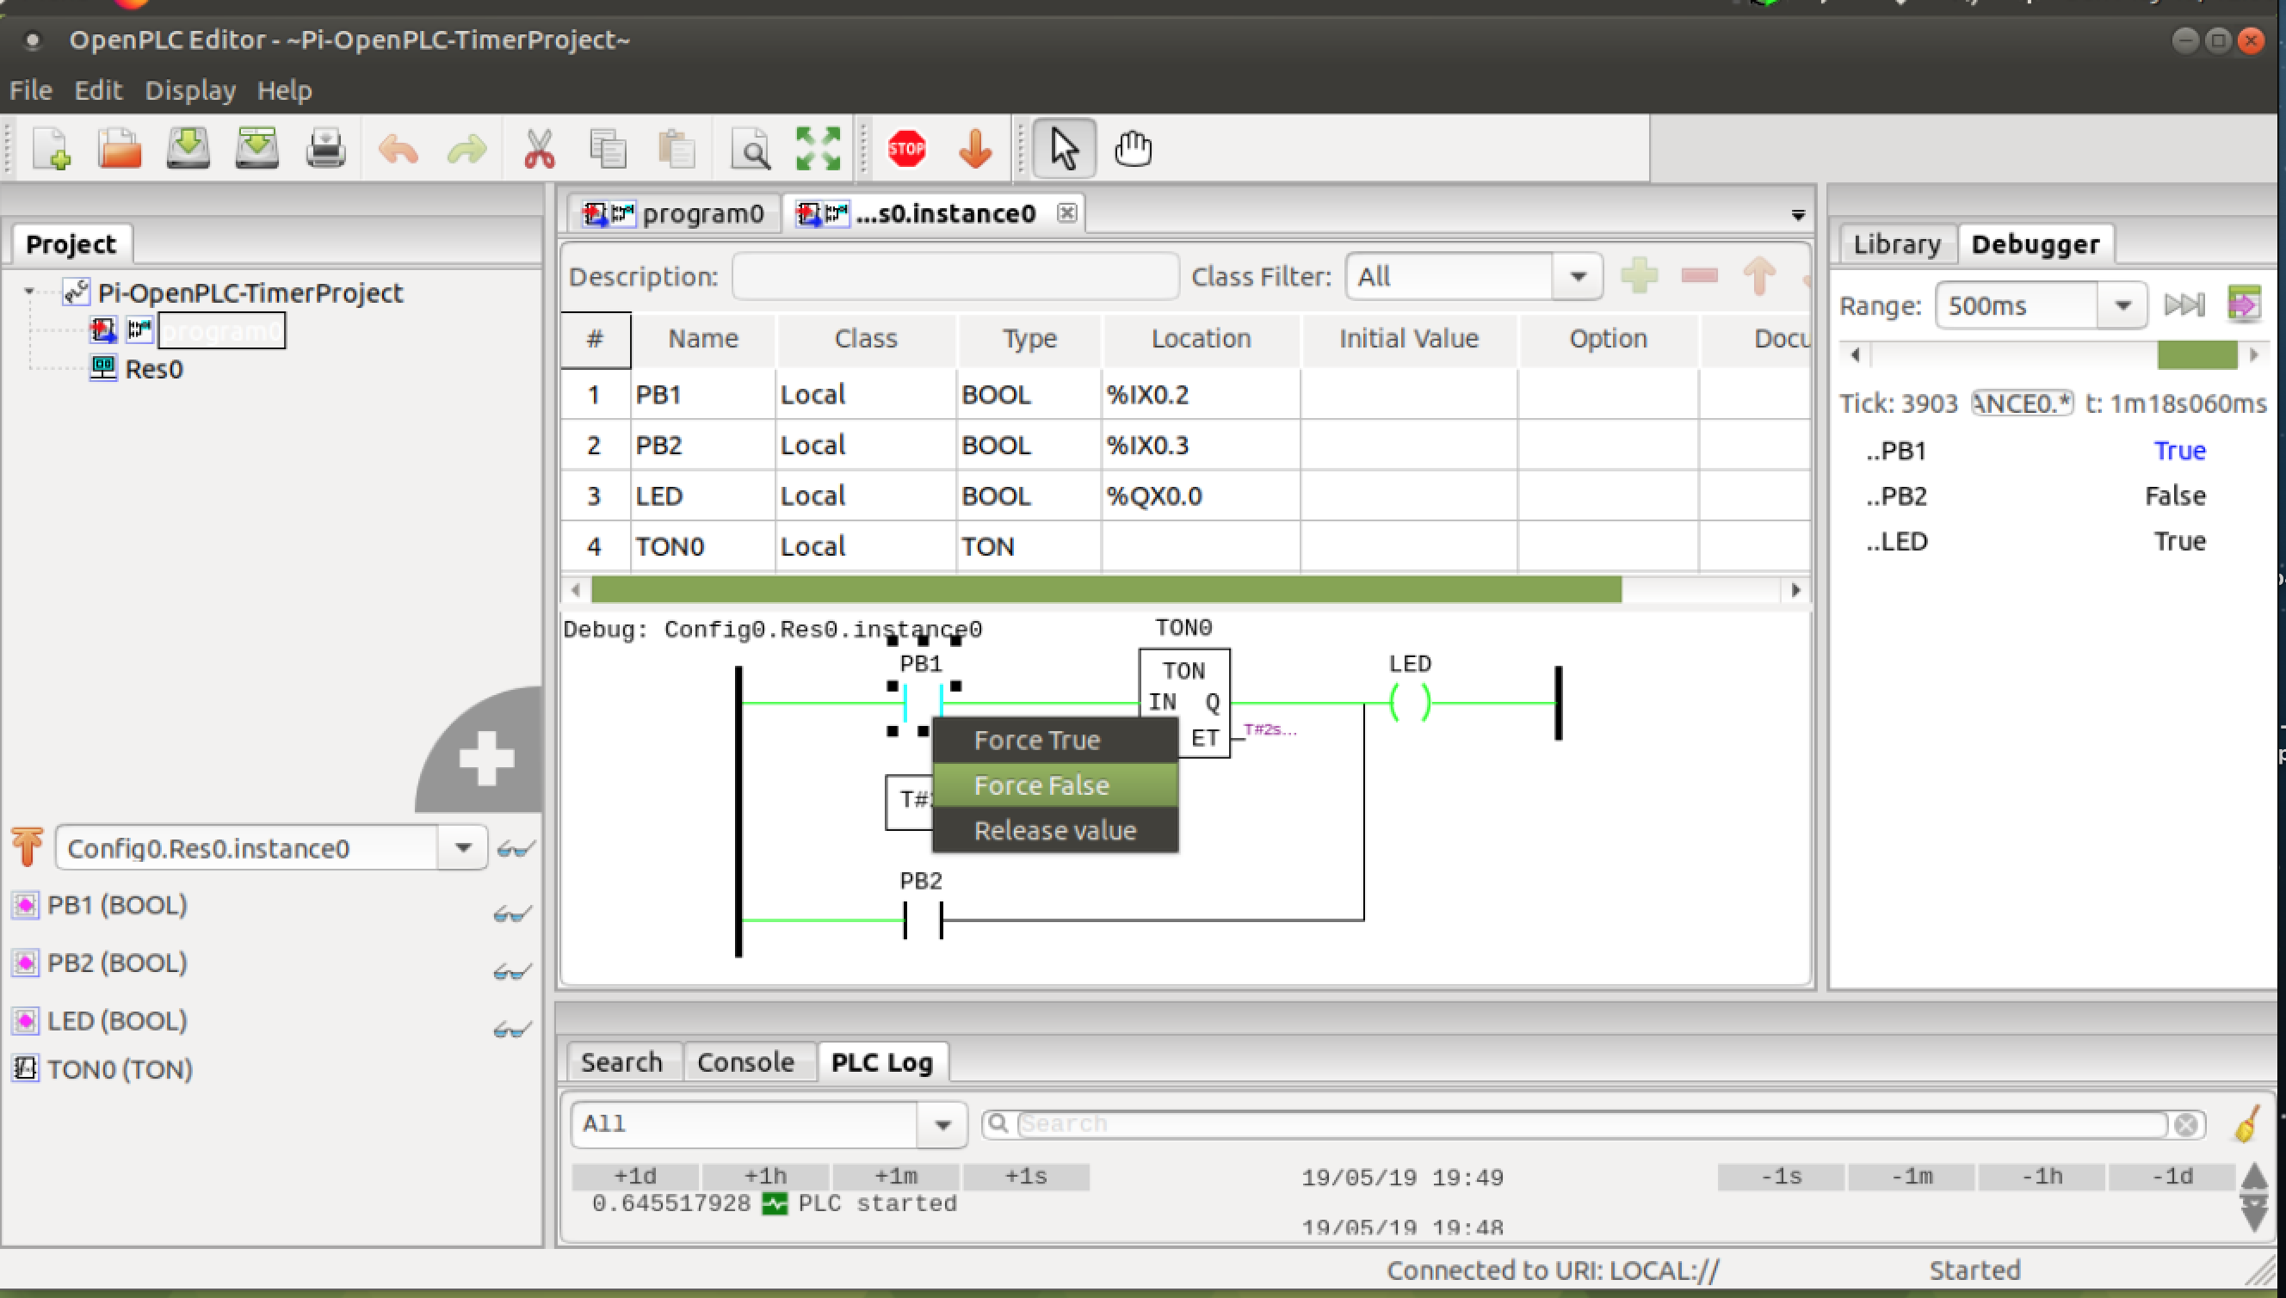
Ladder Logic Simulation - 7
Force PB1 to false to simulate button not pressed

Slide 13
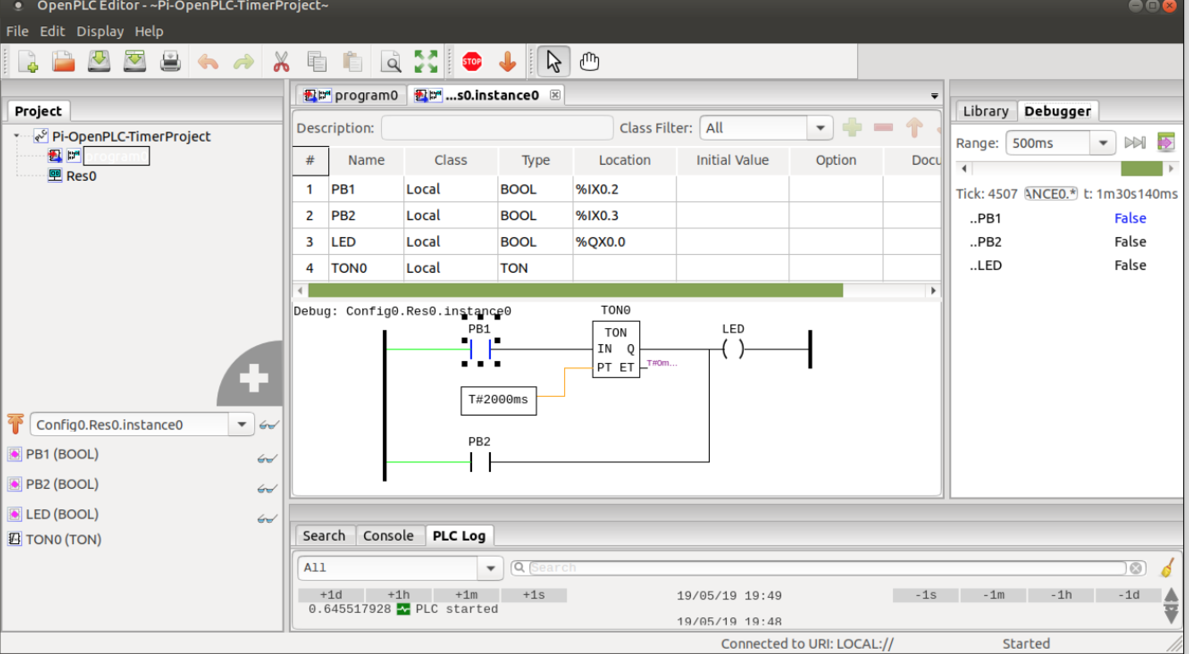
Ladder Logic Simulation - 8
LED coil will be de-energized after 2 sec
LED stops emitting light
Note: Hit STOP sign to end simulation

Slide 14
Suggested Reading
The OpenPLC Project
https://www.openplcproject.com/
Tommy Morris – Six SCADA Modules
https://clark.center/details/tommy_morris/Six%20SCADA%20Modules

Slide 15
Hands-On Laboratory Exercise #2

Slide 16
Laboratory Exercise #2 Instructions - 1
Objective
Learn how to use OpenPLC Editor’s simulator to verify correctness of a Ladder Logic program

Slide 17
Laboratory Exercise #2 Instructions - 2
Use OpenPLC Editor to simulate the First Project Ladder Logic as described at the URL
https://www.openplcproject.com/reference-your-first-project
Force each input PB1 and PB2 through all possible combinations of input states
PB1 state | PB2 state | LED status
Unpressed | Unpressed
Pressed | Unpressed
Unpressed | Pressed
Pressed | Pressed
https://www.openplcproject.com/reference-your-first-project

Slide 18
Laboratory Exercise #2 Instructions - 3
Sample Deliverables
Screenshots of Ladder Logic program simulation including forcing of PB1 and PB2 to have all possible combinations of states
Completed table as shown below
PB1 state | PB2 state | LED status
Unpressed | Unpressed
Pressed | Unpressed
Unpressed | Pressed
Pressed | Pressed

